Slide 1
20ITT41 & PRINCIPLES OF COMMUNICATION
Unit - III Digital Modulation
S.Janarthanan
Assistant Professor( SL.G)
Department of EIE
Kongu Engineering College
Perundurai,Erode-638060

Slide 2
20ITT41 & PRINCIPLES OF COMMUNICATION
Preamble This course explains the concepts of Analog and Digital communication systems that are used for the transmission of information from source to destination. A detailed quantitative framework for analog and digital transmission techniques is addressed.
Unit - I Amplitude Modulation: 9+3
Principles of amplitude modulation – AM envelope - Frequency spectrum and bandwidth - Modulation index and percentage modulation - AM power distribution - AM modulator circuits – Low level AM modulator - AM transmitters – Low level transmitter - AM receivers – Super heterodyne receivers
Unit - II Angle Modulation: 9+3
Angle Modulation – FM and PM waveforms - Phase deviation and modulation index - Frequency deviation - Direct FM and PM demodulators - Frequency spectrum of angle modulated waves - Bandwidth requirement - Narrowband FM and Broadband FM -Average power - FM and PM modulators, Direct FM transmitter - Angle modulation Vs. Amplitude modulation –Indirect FM transmitter.
Unit - III Digital Modulation: 9+3
Sampling - Time Division Multiplexing - Digital T-carrier System – Pulse code modulation – Amplitude shift keying – Frequency and phase shift keying – Modulator and demodulator - bit error rate calculation.
Unit - IV Data Communication: 9+3
Data communication codes: ASCII - BAR codes - Error Control - Error Detection - Redundancy checking - Error Correction -Hamming – Line coding: AMI – NRZ - RZ - Serial interfaces : RS232 - RS485 - Data communication circuits – Data communication modems - Public Switched Telephone Network(PSTN) – ISDN.
Unit - V Spread Spectrum: 9+3
PN sequence code and its properties- Direct sequence spread spectrum system - Processing gain- Frequency hopping spread spectrum.

Slide 3
20ITT41 & PRINCIPLES OF COMMUNICATION
TEXT BOOK:
1. Wayne Tomasi, “Electronic Communications Systems: Fundamentals through Advanced”, 5th Edition, Pearson Education,
2008.
REFERENCES:
1. Michael Moher and Simon Haykin, “Communication System”, 5th Edition, Wiley India Pvt. Ltd., New Delhi, 2011.
2. Frenzel and Louis E., “Principles of Electronic Communication Systems”, 3rd Edition, Tata McGraw Hill Publishing Company,
New Delhi, 2008.
3. Anokh Singh, “Principles of Communication Engineering”,S. Chand & Co., New Delhi, 2006.
COURSE OUTCOMES:
On completion of the course, the students will be able to
CO1 illustrâtes amplitude modulation techniques Applying (K3)
CO2 use the different angle modulation schemes Applying (K3)
CO3 apply the concepts of digital modulation techniques Applying (K3)
CO4 detect and correct the errors introduced in the channel using error control coding schemes Applying (K3)
CO5 illustrate the spread spectrum techniques for modern communication Applying (K3)

Slide 4
Sampling

Slide 5
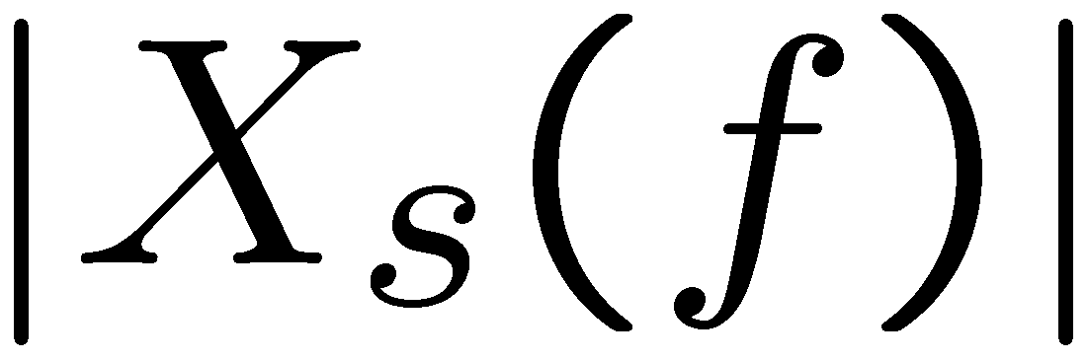
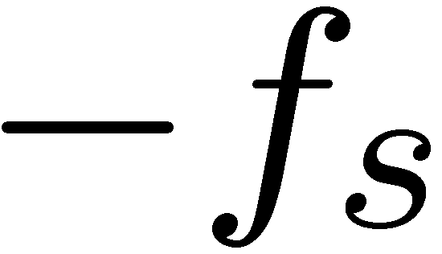
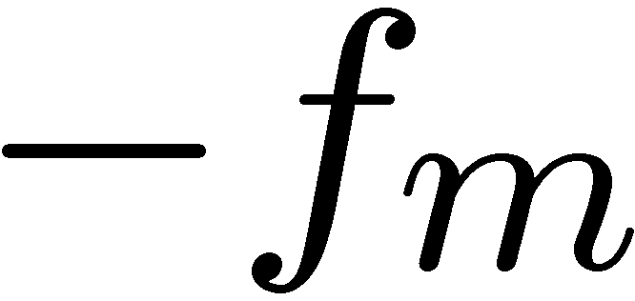

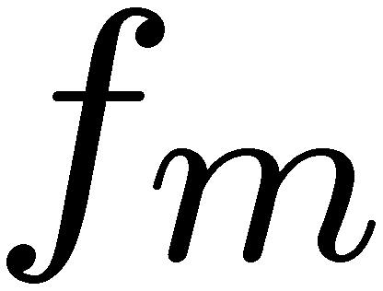


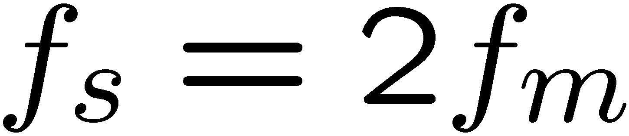
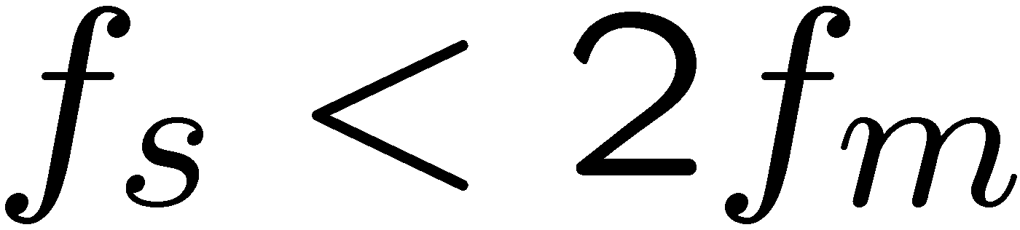
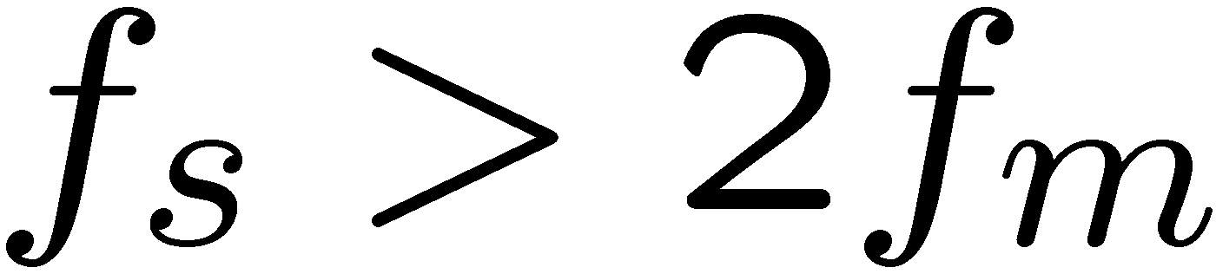
Aliasing effect & Nyquist Rate
LP filter
Nyquist rate
aliasing

Slide 6
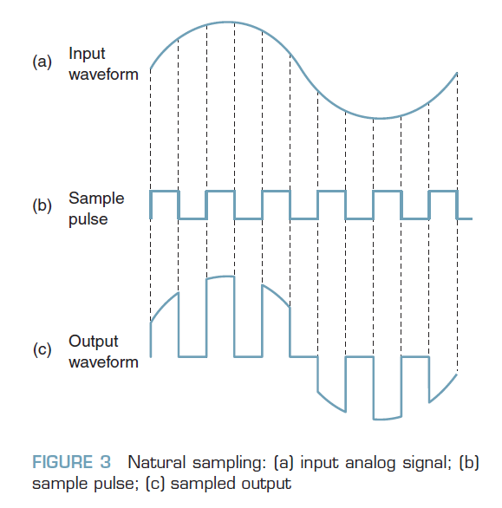
Natural Sampling
Natural sampling is when tops of the sample pulses retain their natural shape during the sample interval, making it difficult for an ADC to convert the sample to a PCM code.
With natural sampling, the frequency spectrum of the sampled output is different from that of an ideal sample.

Slide 7
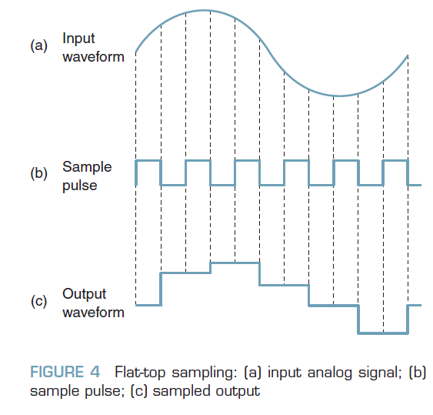
Flat Top Sampling
To overcome the Natural sampling draw back, the flattop
Sampling is introduced, which is accomplished in a sample-and-hold circuit.
The purpose of a sample and- hold circuit is to periodically sample the continually changing analog input voltage and convert those samples to a series of constant-amplitude PAM voltage levels.
With flat-to sampling, the input voltage is sampled with a narrow pulse and then held relatively constant until the next sample is taken.

Slide 8
Bit rate and Baud rate
Bit rate is the transmission of a number of bits per second.
Baud rate is defined as the number of signal units per second.
Or Also it is defined as per second number of changes in signal.
Bit rate = baud rate x the number of bits per signal unit Baud rate = bit rate / the number of bits per signal unit
Reference Source: https://bytesofgigabytes.com/embedded/bit-rate-and-baud-rate/

Slide 9
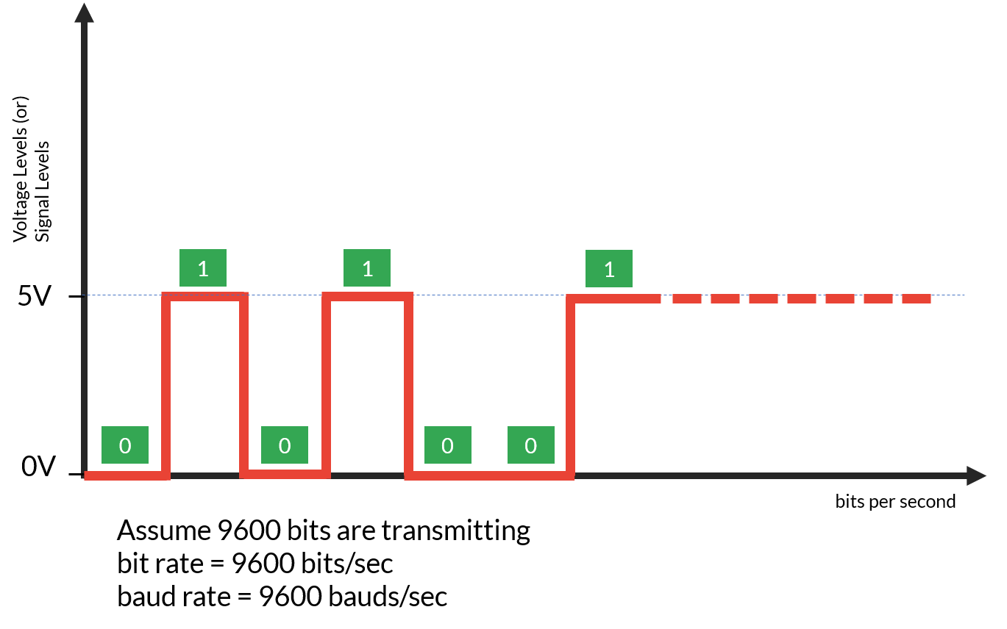
Bit rate and Baud rate
In binary signaling, number of signal level changes are equal to number of bits transferred within a second because one bit at time represents either of two signal levels. That’s why bit rate and baud rate are same in binary signaling.
= baud rate x the number of bit per baud
= baud rate x the number of bit per baud

Slide 10
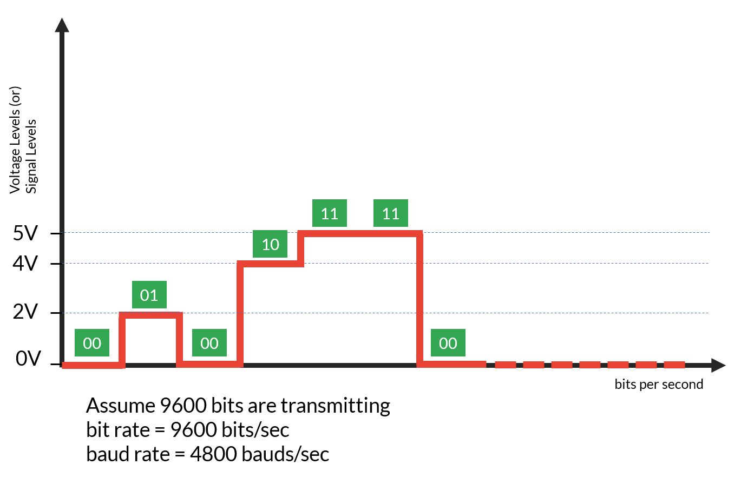
Bit rate and Baud rate
In multi level signaling, there are more than two voltage or signal levels. To represent those signal levels, we require more than one bit. Number of bits required to represent voltage levels is obtained by using following formula.
M-ary Encoding:
N=log₂(m) =3.32log(m) where
N=Number of bits required to represent signal or voltage levels m=number of signal or voltage levels.
Example: To represent 4 voltage levels you required at least 2 bits. Put m=4 in above formula , you will get N as 2.

Slide 11

Baud and Minimum Bandwidth
Baud is the reciprocal of the time of one output signaling element, and a signaling element may represent several information bits.
N=log2(m) where
N=Number of bits required to represent signal or voltage levels m=number of signal or voltage levels.
where
baud = symbol rate (baud per second)
ts = time of one signaling element (seconds)
A signaling element is sometimes called a symbol and could be encoded as a change in the
amplitude, frequency, or phase.
Minimum Nyquist bandwidth or minimum Nyquist frequency:
fb = 2B,
where fb is the bit rate in bps
and B is the ideal Nyquist bandwidth.
Bandwidth = Number of bits per second/ number of bits required per
signaling element
Bandwidth = f_{b}/N

Slide 12

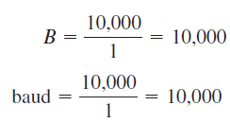
problem
Determine the baud and minimum bandwidth necessary to pass a 10 kbps binary signal using amplitude shift keying.
For Binary signal N=1
For ASK, N = 1, and the baud and minimum bandwidth are

Slide 13


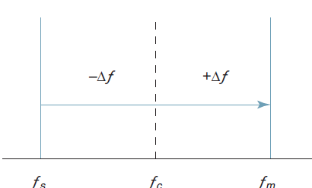
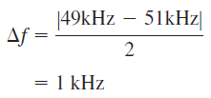

Problem
Determine (a) the peak frequency deviation, (b) minimum bandwidth, for a binary FSK signal with a mark frequency of 49 kHz, a space frequency of 51 kHz, and an input bit rate of 2 kbps.

Slide 14
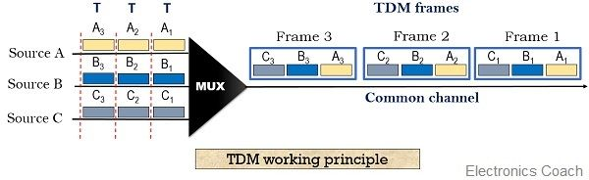
Time-Division Multiplexing
Multiplexing allows the transmission of several signals over a common channel.
Time division multiplexing, the complete signal gets transmitted by occupying different time slots
Reference: https://electronicscoach.com/time-division-multiplexing.html

Slide 15
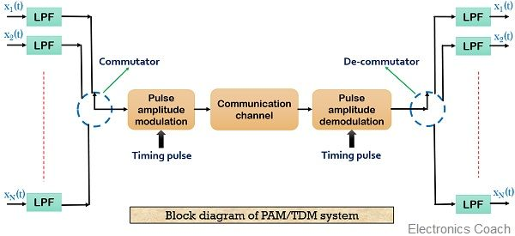
TDM system
Reference: https://electronicscoach.com/time-division-multiplexing.html

Slide 16
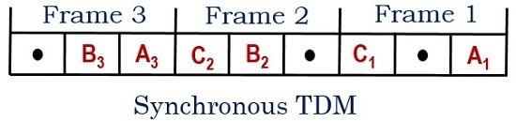
TDM Types
1.Synchronous TDM
2. Asynchronous TDM
Synchronous TDM: In this technique, the time slots are assigned at the beginning, irrespective of the idea about the presence of data at the source. This leads to the wastage of the channel capacity. As in the absence of any data unit, that particular time slot gets entirely wasted.
Reference: https://electronicscoach.com/time-division-multiplexing.html

Slide 17
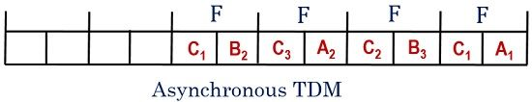
TDM Types
1.Synchronous TDM
2. Asynchronous TDM
2. Asynchronous TDM: It is also termed as statistical or intelligent TDM technique as it eliminates the drawback of wastage of time slot present in synchronous TDM.
Reference: https://electronicscoach.com/time-division-multiplexing.html

Slide 18
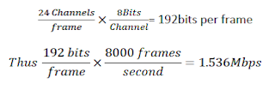

Digital T-carrier System
Each T1 frame consists of 24 * 8 = 192 bits + 1 bit for framing = 193 bits/frame.
There are 8000 frames generated per second (or 125 µsecond/frame).
The gross data rate of T1 = 8000 frames/sec * 193 bits/frame = 1.544 Mbps
For transmitted digital data, the 24th channel is used for synchronization and is considered as overhead.
An additional bit (called framing bit) is added to each frame. The framing bit occurs once per frame (8000bps rate) and recovered in receiver, where it is used to maintain frame and sample synchronization between TDM transmitter and receiver. So each frame contains 193 bits and line speed for T1 digital carrier system is

Slide 19
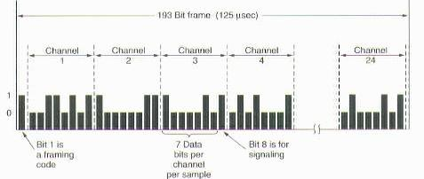
Digital T-carrier System
Each T1 frame consists of 24 * 8 = 192 bits + 1 bit for framing = 193 bits/frame.
There are 8000 frames generated per second (or 125 µsecond/frame).
The gross data rate of T1 = 8000 frames/sec * 193 bits/frame = 1.544 Mbps
For transmitted digital data, the 24th channel is used for synchronization and is considered as overhead.

Slide 20
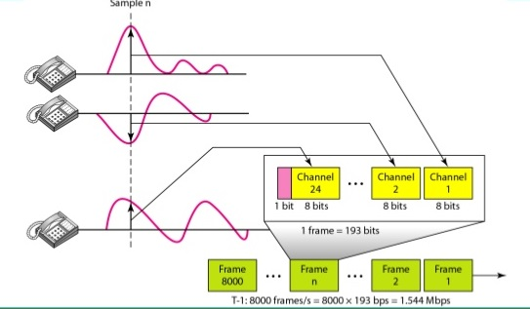
Digital T-carrier System- Frame Structure

Slide 21
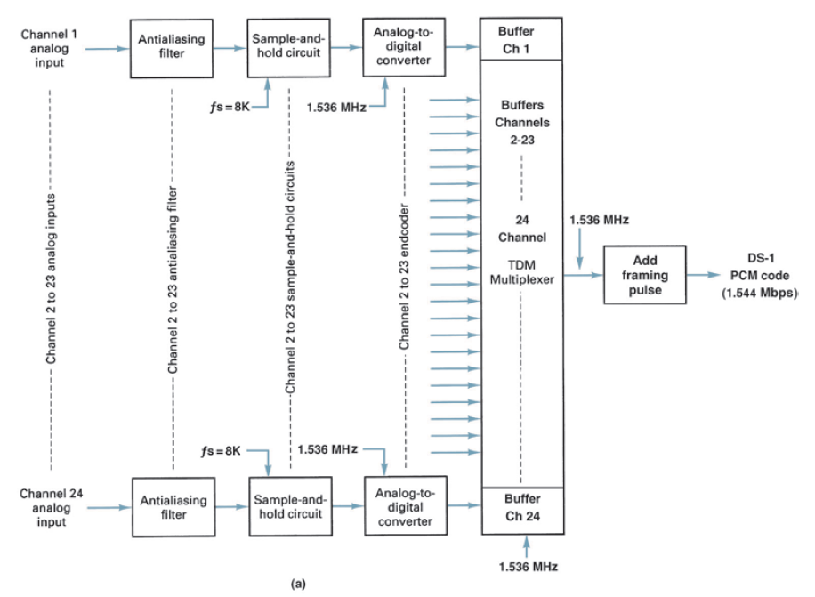
Digital T-carrier System Block diagram

Slide 22
Digital T-carrier System
Stream type | Speed (Mbps) | Equivalent T1s | Equivalent voice channels
DS0 | 0.064 | 1/24 | 1
DS1 | 1.544 | 1 | 24
DS1C | 3.152 | 2 | 48
DS2 | 6.176 | 4 | 96
DS3 | 44.736 | 28 | 672
DS3C | 89.472 | 56 | 1344
DS4 | 274.176 | 168 | 4032

Slide 23
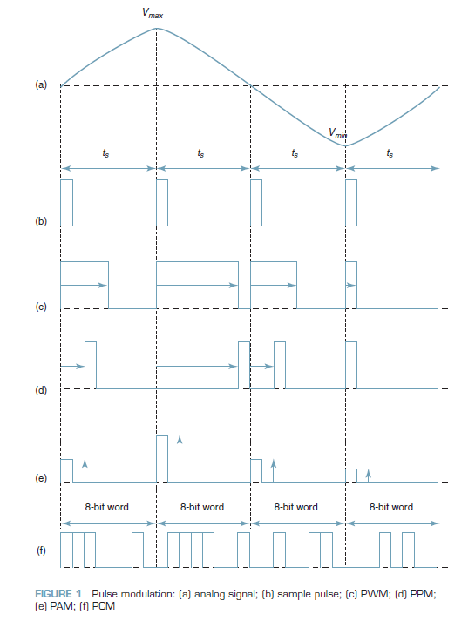
Pulse code modulation
The analog signal is sampled and then converted to a serial n-bit binary code for transmission.
Each code has the same number of bits and requires the same lengt of time for transmission

Slide 24
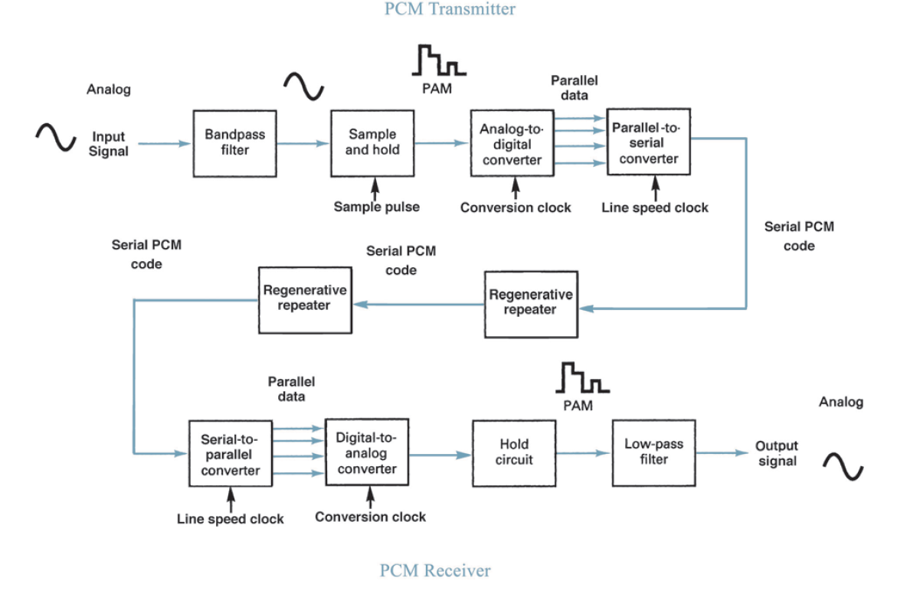
Pulse code modulation

Slide 25
Amplitude shift keying

Slide 26
Frequency and phase shift keying

Slide 27
Modulator and demodulator

Slide 28
bit error rate calculation

